Slide 1


Election Judge Training
Montana Secretary of State, Election and Voter Services
State Capitol Building
1301 E. 6th Ave, Room 260
PO Box 202801
Helena, MT 59620
sosmt.gov soselections@mt.gov 406-444-9608

Slide 2
Election Judge Facts
For the 2022 general election, more than 775,000 citizens served as election judges.
Election Judges play a critical role in the voting process!
On Election Day, a citizen’s right to cast a vote and have the vote count rest in the hands of the ELECTION JUDGE!
There are not many jobs that go through as much change as the job of an election judge.
Election judges must be aware of changes in statute or rules and must follow those changes.
There are few jobs as critical to our democracy as the job of an election judge.

Slide 3
Election Judge Training
  Each election judge must attend training provided by the county Election Office on even years before the primary election.
  Each election judge must be provided with a copy of the Secretary of State’s Election Handbook.
  Each election judge should be provided with a copy of the Secretary of State’s Uniform Ballot & Voting Systems Procedures Guide, or an equivalent publication from the county Election Office.
Please direct questions to your county Election Administrator or the
Secretary of State, Elections and Voter Services Division at: soselections@mt.gov

Slide 4
Election Judge Training
1. Before the Polls Open
2. Election Day at the Polling Place
3. Assisting Voters with Disabilities
4. Closing the Polls
  This training is provided to supplement local training, the Election Handbook, and the Uniform Ballot & Voting Systems Procedure Guide.
  It takes approximately one hour to complete the nine categories which includes a quiz at the end.
  Election judges are encouraged to review this training presentation before each statewide primary and statewide general election.
5. General Counting Procedures
6. Hand-Counting Ballots
7. Machine Tabulating Ballots
8. Special Situations
9. Quiz

Slide 5
Before the Polls Open

Slide 6

Before the Polls Open
  Check the voting equipment, make sure it is set-up, plugged in, properly sealed, and ready for use.
  Check the register to make sure it is the correct register for your precinct.
  Check ballots to make sure they are the correct ballots for your precinct and that ballots are correctly numbered.
  The Chief Judge or Ballot Judge will verify the Ballot Certification Report with ballots delivered to the polling place and will verify and update the ballot seal log and the voting system seal log.
    Notify the Election Administrator immediately if the number of ballots delivered does not match the number on the Ballot Certification Report.
Call your county Election Office immediately if you are missing any supplies.

Slide 7
Chain of Custody and Security Seal Log (Page 1).
This form is used to track the chain of custody of ballots and media, and to track security seals.

Slide 8
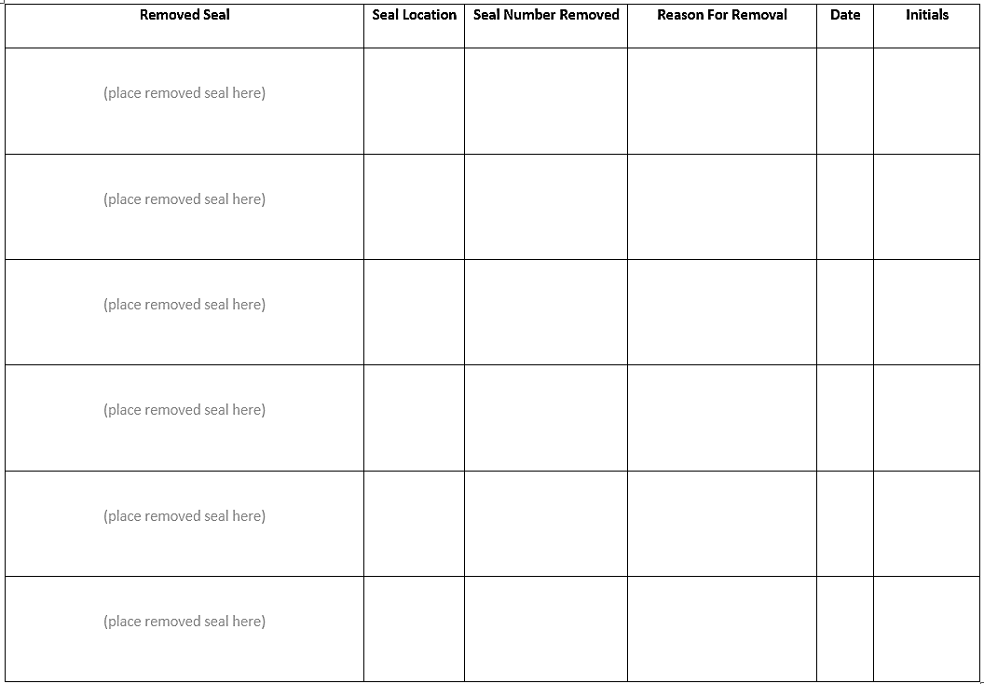
Security Seal Log (page 2) Place used security seals here; log seal numbers here.

Slide 9

Before the Polls Open
PRECINCT #21
POLLING PLACE - VOTE HERE
  Post Polling Place signs outside the polling
  place in conspicuous locations.
  Post Precinct signs inside the polling place
  in conspicuous locations to direct the voter to
  the correct precinct.

Slide 10
The Absentee Voter List
  Using the list provided by the Election Office, mark the Register for any voter who was issued an absentee ballot after the Register was printed.
  All voters who were issued absentee ballots prior to printing the Register will be marked “Absentee”.
NOTE: Voters marked “Absentee” must vote a PROVISIONAL BALLOT if they show up to vote at the polls and do not have their original ballot!
  Post the list of absentee voters in a conspicuous location.

Slide 11
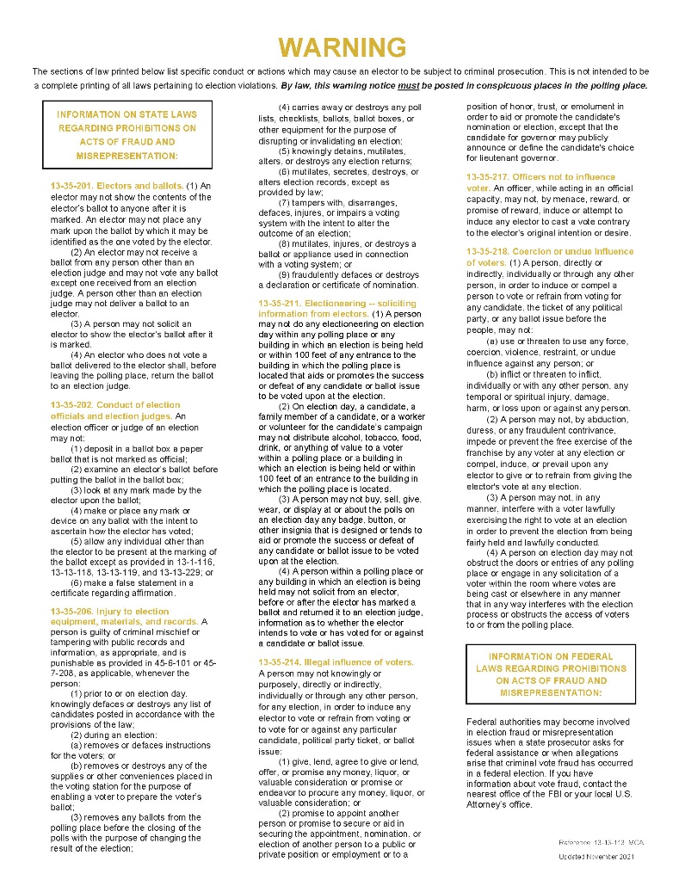
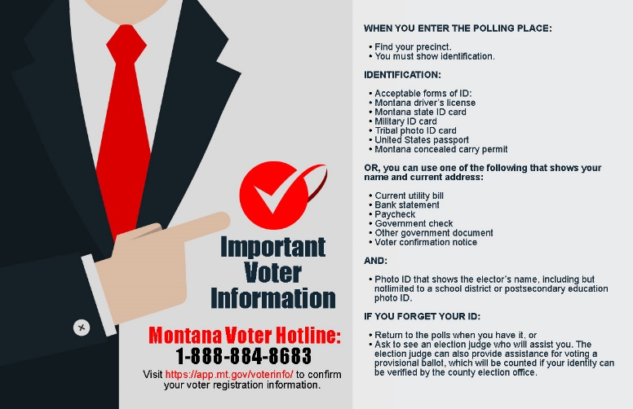
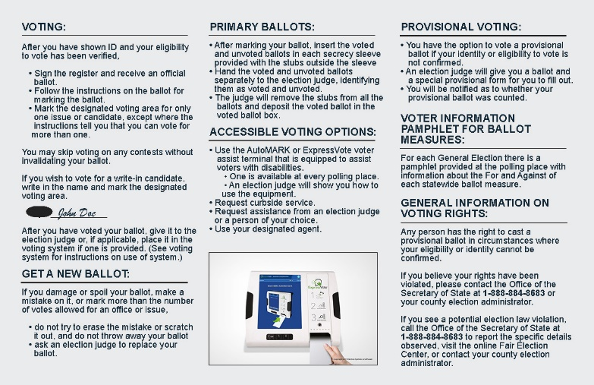
Setting up the Polling Place
Set up the Precinct Table to include the following items:
Precinct register and poll book
Ballots and official ballot stamp & ink pad
Sealed ballot containers including unvoted ballot container for primary election, and stub container.
Secrecy sleeves
Voter Registration forms
Polling Places Forms
Provisional envelopes and provisional ballot container
Voter Information Pamphlets (if applicable)
Other supplies as directed by Election Administrator
Set up a Montana Voter Information notice in each booth.
Post the Warning Notice in a conspicuous location.

Slide 12
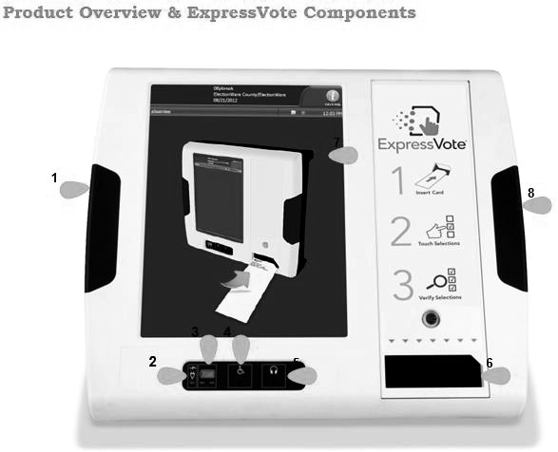
ExpressVote®
    Make sure the ExpressVote® is set up, plugged in, turned on, and the keys are removed and in the possession of the designated judge.
    Make sure the ExpressVote® is set up so voting can be done in private, and there is a privacy shield around the screen.
    Insert the media card if it has not already been installed by the Election Administrator.
  Place numbered seal over the sliding media door and record # on the seal log.

Slide 13
ExpressVote® (continued)
  Run several test ballots through the machine and verify the machine is marking the ballot correctly.
  Throughout the day, a designated judge is responsible for periodically checking the ExpressVote® by running a test ballot through it.
  If there are problems with the ExpressVote®, contact the Election Administrator immediately.
  Refer to ExpressVote® troubleshooting section in the Election Handbook found on the sosmt.gov website.
  If the issues are not resolved see if a backup ExpressVote® is available, or if there is another polling place a voter may go to vote on a functioning ExpressVote®.

Slide 14
Election Day at the Polling Place

Slide 15

Election Judges and Boards
The Election Administrator may provide a manual or specialized training for each type of judge or board (if applicable).
Not all counties use all types of judges and boards.
Below is a sample of different types of judges and boards involved in the election process:
      Ballot Judge Resolution Board
      Poll Book Judge Write-In Board
      Register Judge Absentee Board
      Provisional Judge Tabulating/Counting Judge
Review the Election Handbook and specific County Manual (if provided).

Slide 16

Election Day at the Polling Place
Opening the Polls
The Chief Election Judge or Polling Place Manager will proclaim the opening of the polls aloud at the time set for opening.
Polls in Montana must open at 7:00 a.m. unless the polling place has fewer than 400 poll voters, in which case it may open at noon.
See 13-1-106, MCA for details.

Slide 17
Election Day at the Polling Place
  The Election Administrator will prescribe duties to the election judges to ensure the elections are secure, fair, accurate and accessible to all electors. These duties may include the following:
    Swear in other judges in precinct/polling place
    Check seals on voting equipment
    Verify and sign the Ballot Certification Report form
    Direct placement of instructions and signs
    Monitor traffic flow, supplies, and troubleshoot if necessary
    Periodically check booths and equipment
Chief Election Judge / Polling Place Manager/Register Judge/Poll Book Judge/Ballot Judge

Slide 18

Election Day at the Polling Place
Pursuant to a September 30, 2022, District Court Order, acceptable identification for an elector at the polling place is a current photo identification showing the elector’s name OR a current utility bill, bank statement, paycheck, notice of confirmation of voter registration, government check OR other government document that shows the elector’s name and current address.
The Register Judge will confirm the elector’s identity and eligibility and to vote.
  The Register Judge will ask the elector to see an acceptable form of identification (ID).
  The elector may state their name and current address to assist the Register Judge in finding their name in the register.
  The Register Judge should announce the elector’s name loud enough to be heard by poll watchers.

Slide 19

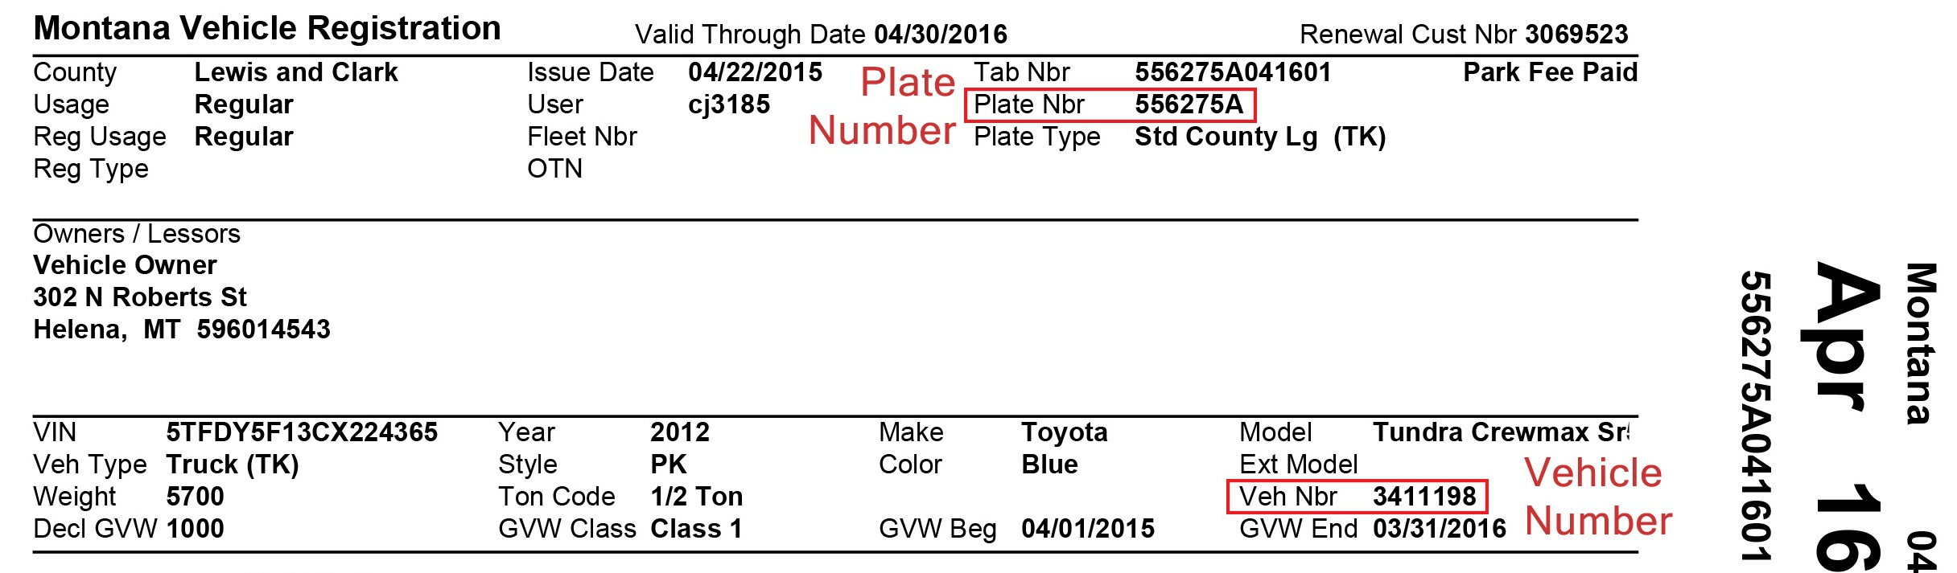
  Acceptable IDs
  Any current photo ID showing the elector’s name, including but not limited to a Montana driver’s license or state identification card, military identification card, tribal photo identification, US passport, Montana concealed carry permit, or school district or postsecondary education photo identification; OR
  A current utility bill, bank statement, paycheck, government check, or other government document that shows the elector’s name and current address.
  Examples: Costco Card (Photo ID) or a vehicle registration with the voter’s name/address.

Slide 20
The Register Judge (continued)
  The Register Judge will locate the elector’s name in the register and have the elector sign the register on the designated line.
NOTE: It is important to make sure the elector signs the register in the correct space. If the elector signs in the wrong space and this is not discovered, they may not get appropriate voting credit.
If the address on the ID is different than the address in the register, the elector should fill out a new voter registration application.
NOTE: The voter may vote one last time at the precinct of their old address.

Slide 21
The Register Judge (continued)
  If the elector’s name does not appear in the register (this may be handled by Provisional Judge, depending on county procedures):
    Check the countywide VR list to see if the elector is in the wrong precinct or call the Election Office to see if they can determine why the elector is not listed.
    If the elector asserts they registered with the Motor Vehicle Department (MVD), call the Election Office and they can contact MVD or the Secretary of State’s Office (SOS).
  If it is confirmed the elector was erroneously omitted from the register, have the elector sign the Certificate of Erroneous Omission form and then the register. Attach the form to the register and issue a regular ballot.

Slide 22
The Register Judge (continued)
If the elector does not have acceptable ID with them, but expects to be able to provide proper identification, the voter may vote a provisional ballot.
    An elector who votes a provisional ballot has until 5:00 p.m. the day after the election to provide a verifiable ID to the Election Office (or mailed and postmarked no later than the day after election day).
  If the register indicates the elector is provisionally registered, it means their ID could not be verified at the time of registration. Send the elector to the Provisional Judge to have the ID verified/resolved with the Election Office.
    If the ID can be verified/resolved by the Election Office, the elector goes back to the Register Judge, signs the register and votes a regular ballot.
    If the ID cannot be verified/resolved, the elector votes a provisional ballot and has until 5:00 p.m. the day after the election to provide a verifiable ID to the Election Office (or mailed and postmarked no later than the day after election day).

Slide 23

The Poll Book Judge
The Poll Book Judge records the electors voting and ballots issued.
  After the Register Judge has processed the elector, write the elector’s name in the Poll Book beside the ballot number provided by the Ballot Judge.
  Ensure the number on the next ballot stub is the same as the number in the Poll Book.
  If a ballot number is missing from the ballot, or if the ballot is voided, clearly note this fact in the Poll Book.
  At the end of the day, the Poll Book must be reconciled to the number of ballots issued using the Ballot Reconciliation Report, so it is important to pay close attention to the ballot numbers.
  If there is early pickup of ballots for counting, additional poll books will be needed.
    Make sure subsequent poll books (after early pickup) are started on the correctly numbered line.
    Make sure all judges sign the poll book(s) before each pickup.
    Complete appropriate portion of the Ballot Reconciliation Report before turning poll book over to counting judges.

Slide 24
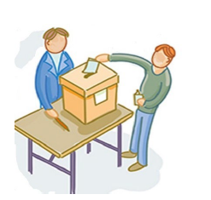
The Ballot Judge
The Ballot Judge issues ballots to electors in sequential order, providing the ballot numbers to the Poll Book Judge.
  Give the next ballot # to Poll Book Judge.
  Stamp the ballot with the official ballot stamp.
    Make sure no part of the stamp appears on the stub.
  Demonstrate to the elector the procedure to place a voted ballot in secrecy sleeve.
  Instruct elector to return voted ballot to the appropriate judge.
  When elector returns with ballot, remove stub from the ballot and place in stub box.
  Place voted ballot into the ballot box in a way that ensures that no part of the voted ballot is visible.
  In a primary election the elector is given one ballot for each Party.
        Make sure the stub numbers on each Party ballot match.
        Instruct the elector to vote only one Party’s ballot(s) and to return all party ballots to you, designating which ballot is the voted ballot.
  NOTE: The unvoted ballot(s) goes in the stub box or in the unvoted ballot box, depending on your set-up.

Slide 25
The Ballot Judge (continued)
  Spoiled Ballot - If an elector spoils or damages the ballot, a new ballot must be provided to the elector upon request.
NOTE: No stickers or labels may be placed by an election judge on the ballot; a new ballot must be issued.
  The Poll Book Judge must be notified to designate the ballot as “spoiled” in the poll book and enter the voter’s name with the new ballot number.
    The elector should write “spoiled” on the spoiled ballot, and the Ballot Judge may write “spoiled” on the stub.
    The spoiled ballot should be placed in an envelope marked “spoiled ballot” and deposited in the designated container, and the spoiled stub should be placed in the stub box or other designated container. (If using precinct counters, the spoiled ballot should go in the stub box)

Slide 26
The Ballot Judge (continued)
The Ballot Judge (or Precinct Counter Judge) receives the ballot from the elector then remove the stubs. The stubs are placed into a stub or other designated container.
  If using a precinct counter, instruct the elector to insert the ballot into the precinct counter.
    Instruct the elector to watch the number on the scanner change to ensure that ballot was accepted.
    Assist the elector if the scanner reports an error.
        See the DS200®/DS300® Troubleshooting section in the Election Handbook.
        Do NOT look at the elector’s ballot while assisting.

Slide 27
The Provisional Judge
  The Provisional Judge is responsible for assisting electors who required to vote a provisional ballot because they do not meet the eligibility to vote a regular ballot.
    The voter did not have appropriate ID when appearing to vote or the ID number provided could not be verified by the Election Office; or
    The voter appears in the register as having been issued an absentee ballot; or
    The voter does not appear in the register and claims to have registered, but registration cannot be verified by the Election Office; or
    The voter's registration has been challenged.
    If the ID / registration issue can be resolved by the Election Office, send the elector back to the Ballot Judge to vote a regular ballot as indicated by the Election Office.

Slide 28
The Provisional Judge (continued)
  If the elector cannot provide ID or if the ID number cannot be verified:
    Provide the elector with the Provisional Ballot Instructions and review the instructions with them.
    Assist the elector with filling out the Provisional Checklist on the Provisional Ballot Envelope and fill out the election judge portion.
    Send the elector back to the Register Judge with the Provisional Ballot Envelope to complete the process to be issued a ballot.
  If the elector has been issued an absentee ballot and claims it was not received, was lost, or destroyed:
    Provide the elector with Provisional Ballot Instructions and review the instructions with them.
    Assist the elector with filling out the Provisional Ballot Envelope; you will fill out the Election Official section(s).
    Send the elector back to the Register Judge with the provisional envelope to complete the process and be issued a ballot.

Slide 29
The Provisional Judge (continued)
  When an elector is being challenged by another elector:
      If challenge cannot be resolved immediately (see Challenge section of the Election Handbook):
        Provide the elector with Provisional Ballot Instructions and review the instructions with them.
        Assist the elector with filling out the elector portion of the Provisional Ballot Envelope; you will fill out the Election Official section(s).
        Send elector back to the Register Judge with provisional envelope to complete the process and be issued a ballot.
  Make sure elector has completed all provisional materials and has signed the Provisional Ballot Envelope.
  Make sure the Ballot Judge returns voted provisional ballots to you to place in container marked “Unverified Provisional Ballot Container.”

Slide 30
Provisional Ballot Cover Sheet/Outer Envelope
The Provisional Judge assists the elector with completing Section 1 of the envelope.
Make sure the elector signs this section.
The Provisional Judge then completes Section 2, signs the form, and gives it to the elector to take back to the Register judge.
Section 3 is completed by the
election official when the ID/registration issue is resolved.

Slide 31
The Provisional Judge (continued)
  If the elector resolves the provisional ballot in time for counting on election night:
      Retrieve the provisional envelope from the unverified container and mark the envelope to indicate the ballot was resolved.
      Give the envelope to the elector and direct the elector back to the Ballot Judge.
      The Ballot Judge will instruct the elector to enter a voting booth, remove the ballot from the provisional envelope, place it in the secrecy sleeve, and return the ballot to the Ballot Judge.
  The Ballot Judge will place the ballot in the ballot box or the elector will place the ballot in a precinct counter.
  The provisional envelope will be placed in the container marked “Verified Provisional Ballot Container.”

Slide 32
Absentee Voters at the Polling Place
  A voter with an absentee ballot is allowed to drop the ballot off on election day at any polling place in the county.
  An absentee ballot dropped off at a polling place other than the one in which the elector appears on the register must be:
      delivered to the Election Office for signature verification and tabulation if tabulation of absentee ballots is done at a central location; or
      delivered to the Election Office for signature verification and then to the correct precinct if all counting is done at the precinct location.
  An absentee ballot being dropped off at the polls that is not in the absentee signature envelope must be placed in an absentee signature envelope and must be signed by the voter.
  If multiple ballots are dropped off, any ballots with no envelope, or unsigned envelopes must be treated as provisional until the elector resolves the issue.

Slide 33
Other Polling Place Activities
  See the Election Handbook for detailed information about the following polling place activities:
    Poll Watchers Petition Signature Gathering
    Election Observing Electioneering
  These activities, except electioneering, are allowed at the polling place, but they may not impede the voting process.
  Electioneering may only occur more than 100 feet from any entrance to a polling place.
  A candidate may not serve as a poll watcher at a polling place where the candidate’s name is on the ballot (13-13-120(2) MCA).
  A candidate, family member of a candidate, or a worker or volunteer for a candidate’s campaign may not distribute alcohol, tobacco, food, drink or anything of value to a voter within 100 feet of an entrance to a polling place or building in which an election is being held.

Slide 34
Miscellaneous
  Remember to check voting booths periodically to make sure instructions are up, the ballot marking tool is in the booth, and no one has left anything or marked anything in the booth.
  Wipe any equipment or voting supplies with alcohol-based wipes periodically, and more often if there is a health-related reason.
  Late registrants can also return their ballot to any polling place in the County.
  Check the polling place periodically to ensure the warning poster, sample ballots, and other signs are posted and not defaced.

Slide 35
Assisting Voters with Disabilities

Slide 36

Assisting Voters with Disabilities
There are several situations that may require election judge assistance for voters with disabilities:
  Elector Unable to Sign Register
  Elector Unable to Enter Polling Place (Curbside Voting)
  Elector Requesting Assistance with Marking their Ballot
  Elector requests to use a Voter Interface Device

Slide 37

  Voter Unable to Sign Register
  An elector who is unable to sign their name cannot be denied the right to vote because of the inability to sign the precinct register.
  One option is having an agent who is designated on a prescribed form by the elector to sign for the elector. An agent may sign for any voting process that an elector would sign for.
  If an elector is unable to provide a fingerprint or an identifying mark and has not established an agent, any election official may sign for the elector after reviewing and verifying the elector's identification.
  A notation must be made in the precinct register on the signature line if an elector is unable to sign.

Slide 38
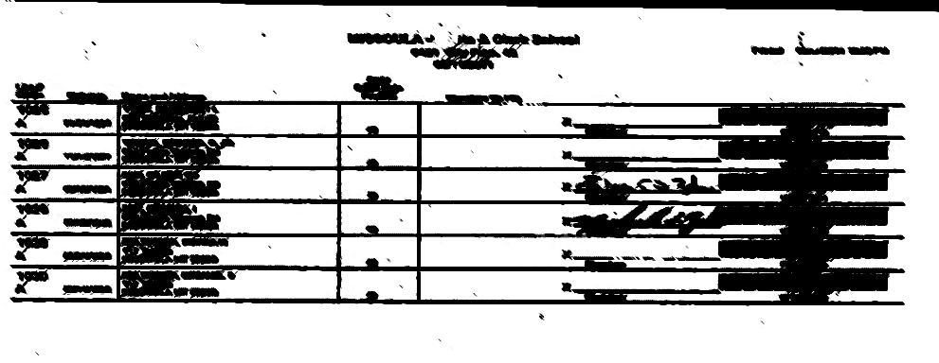
  Voter Unable to Sign Register (continued)
      The elector is permitted to make a mark of some sort on the signature line by the elector’s name. The mark can be a fingerprint or an identifying mark, or another type of mark.
      NOTE: The judge should enter a notation next to the fingerprint that the elector was unable to sign the register. Add the time and the initials of the judge.
Unable to sign -10:15 a.m. dmc

Slide 39
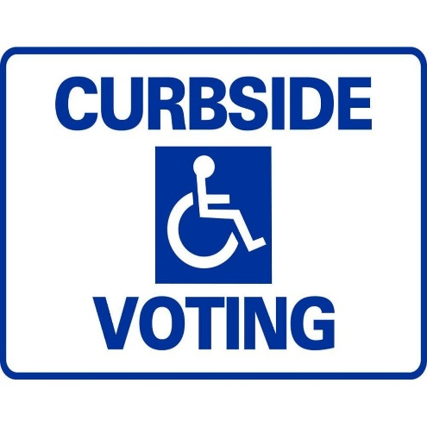
Voter Unable to Enter Polling Place
  Curbside Voting
    Two judges (from different political parties, if possible) will take a blank ballot and the Oath of Elector Unable to Enter Polling Place form outside the polling place to the elector.
    The elector will sign the oath and the two judges will witness the oath.
    After the elector shows appropriate ID, allow the elector to vote.
    Have the elector put the ballot(s) in the secrecy sleeve for transport back into the polling place.
    Deliver the ballot (in the secrecy sleeve) to the Ballot Judge.
    The Ballot Judge will place the ballot in the ballot box. The register and poll book will also be marked.
    Both judges assisting the elector must sign the register.
    Attach the signed Oath to the precinct register.

Slide 40
Voter Needs Assistance Marking Ballot
  Upon request from an elector, two judges (from different political parties, if possible) should assist: one to mark the ballot as requested and one to verify the person marking the ballot is marking as requested.
  If voting booths are not large enough to accommodate 3 people, find a spot specifically set up for use by voters with disabilities that will allow the voter to vote in privacy.

Slide 41

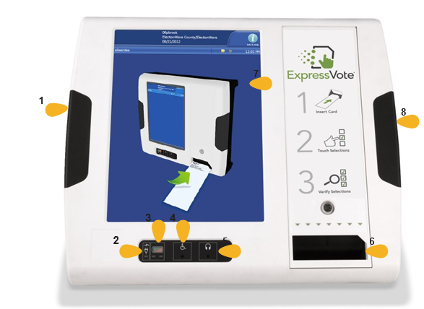
ExpressVote® Voter Assist Terminal
  The ExpressVote® must be available at each polling place.
  Features:
    Ability to magnify ballot for visually impaired voters.
    Braille keys for visually impaired voters.
    Sip and Puff attachment device for voters with mobility impairments.
    Headphones for visually impaired voters.
The Election Administrator will train the appropriate judges on the ExpressVote® Voter Assist Terminal.
Be familiar with the equipment if you are a judge that will be working with it!

Slide 42
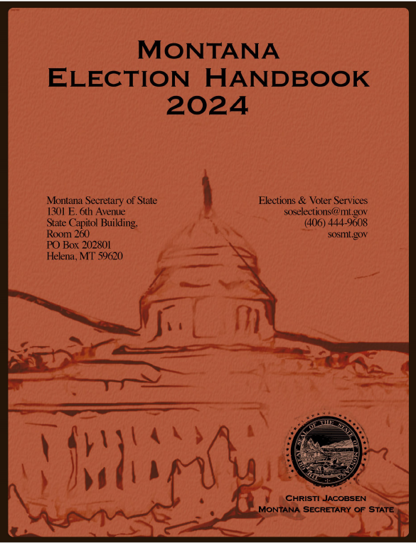
ExpressVote® Voter Assist Terminal (continued)
See the Election Handbook for detailed instructions on using the ExpressVote®.
    See the “Troubleshooting the ExpressVote®” in the Election Handbook when the machine does not appear to be functioning properly.
NOTE: Chief Judges or Polling Place Managers should have the Election Handbook available on election day.

Slide 43
Early Pick-up And Early Counting Of Ballots
Counting votes cast may begin before the polls close, if directed by the Election Administrator. Election judges, ideally one from at least two parties having ballot access, shall meet at a place designated by the Election Administrator. Judges doing the tabulating shall be in a separate room from where ballots are being cast.
Observers may not disclose any results learned before the close of polls under penalty of law. Observers of early counting shall complete and sign the following affirmation:
“I, _____, will not discuss the results of the early counting of votes at any time prior to the closing of the polls on election day.” (13-15-207(4)(a), MCA)
Judges sign the two oaths provided by the Election Administrator. When votes are being counted prior to the close of the polls, in addition to the official oath taken and subscribed to by the election judges, the members of the counting board shall complete and sign the following affirmation:
"I, _____, will not discuss the results of the early counting of votes at any time prior to the closing of the polls on election day." (13-15-207(4)(a), MCA)
Duplicate boxes and poll books will be provided.
NOTE: Make sure all ballots issued and marked in the poll book prior to the early pick-up are deposited in the (early pick-up) ballot box before the box is removed.

Slide 44
Early Pick-up And Early Counting of Ballots (continued)
After verifying the security seal number on the Chain of Custody and Security Seal Log, open the ballot box, remove and count the ballots to compare the total ballots in the ballot box with the number issued as recorded in the poll book, and record the numbers on the Ballot Reconciliation Report. The form must be given to the chief election judge or designee to be delivered to the Election Office.
Check the ballots to be sure the official ballot stamp appears on them.
Judges for hand-count ballots will count all votes on ballots in the first box. That box and the poll book should then be exchanged for subsequent boxes and poll books as necessary, reconciling total ballots to total issued in poll book each time.
Election Judges using a central tabulation center shall:
  Place ballots and poll book in the "Early Pick-up" container, marking the precinct number and total number of ballots enclosed (after reconciling on the Ballot Reconciliation Report the total number of ballots with total issued in poll book) on the outside of container.
  Officially seal the container as required and record the seal number on the Chain of Custody and Security Seal Log; and
  Relinquish the "Early Pick-up" container to authorized personnel for delivery to the counting center and obtain a receipt if required by the Election Administrator.

Slide 45
Early Pick-up And Early Counting of Ballots (continued)
Vote counting continues until votes for all candidates and ballot issues are counted. Any vote count must be open to public observation.
The office canvass board must meet within 14 days of the election to canvass the returns.
Election judges and any other individuals having access to information may not disclose any results of early counting at any time prior to the closing of the polls on election day.
Election Administrator may appoint extra election judges as marshals to be responsible for exchanging ballot boxes and poll books and monitoring the counting board room and observers.

Slide 46
Closing the Polls

Slide 47

Closing the Polls
Loudly proclaim the close of the polling place at 8 p.m.
  An election judge or official must be present to ensure the last person in line at 8 p.m. can vote, and those who appear after 8 p.m. are NOT allowed to vote.
Closing the Polls (if using precinct count systems)
  Polling Place Manager or Chief Judge (or judge designated by the Election Administrator) is responsible for closing the precinct counters and ensuring secure delivery of the properly sealed memory card, ballots, absentee ballots, and provisional ballots to the Election Office or Counting Center. (2 judges must be present during delivery)
  Judges will remove ballots from precinct counters and place the ballots in containers provided for the ballots. The ballots must be sealed and secured for transport to the Election Office or Counting Center.

Slide 48
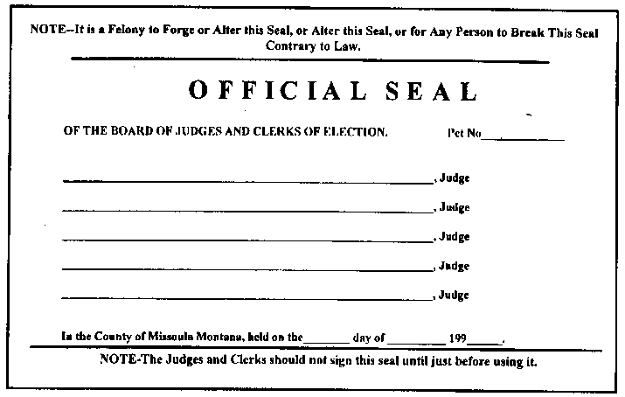
Closing the Polls (continued)
Fill out the back of the poll book (this should be done at the time of each pick-up of ballots if early pickup is occurring) AND SIGN.
  Fill out timesheets and sign. Make sure timesheets go into the correct envelope that is not sealed.
  Take down the instructions and warning posters as directed by the Election Administrator.
    Closing duties will vary by county. Follow the specific instructions for your county.

Slide 49

Closing the Polls (continued)
  Post results if counting is done at the polling place.
  Place supplies, ballots, stubs, etc. into the correct envelope. Follow the instructions on the envelopes.
  Seal the envelope with the official seal AND SIGN.
  NOTE: Do not put timesheets in an envelope that is sealed. Sealed envelopes cannot be opened except as provided by law.
  If instructed to do so by the Election Administrator, make sure you:
    Have polling place picked up and all supplies removed.
    Turn out all lights.
    Lock doors.

Slide 50
General Counting Procedures

Slide 51
General Counting Procedures
In general, counting of ballots may not begin before election day. However, counting of absentee ballots via automatic tabulation is allowed one day prior to election day (13-15-104, MCA).
The count of votes must be public, and anyone may observe the count. Anyone observing the count may not discuss the results at any time prior to the close of the polls on election day (13-15-101, MCA & 13-15-207(4), MCA) and no one may interfere with the count.
The counting of votes must be continuous. The canvass board must meet no later than 14 days after the election to canvass the vote (13-15-401, MCA).
Immediately after each pickup of ballots, reconcile the poll book with the number of ballots to be counted using the Ballot Reconciliation Report.
  If the number of ballots cannot be reconciled with the poll book, state the reason you think they don’t reconcile and have all counting judges sign the Ballot Reconciliation Report.
NOTE: See the Election Handbook for more information on General Counting/Tabulation Procedures.

Slide 52
General Counting Procedures – Close of Tabulating Center
It shall be the duty of the Election Administrator or designee to collect all ballots, logs, and materials used for the counting center and place them in secure storage upon completion of the tabulation of ballots and certification of the results of the election.
    Before adjournment, enclose the items specified in the envelopes provided; see “List of Envelopes for Ballots and Supplies” subsection in the “Appendix” section. Each election judge will sign the election judge’s name across all seals affixed to the official envelopes if instructed to do so on the envelope. These envelopes, with the rest of the supplies provided for the election, are returned to the Election Administrator. (13-15-205, MCA)

Slide 53
Ballot Reconciliation Report:
Find at the back of each poll book.
Make sure you have 2 copies, one to be sealed and returned with each poll book, one for the Election Administrator.
These 2 numbers should match.
Enter the total number of ballot sheets in ballot box.

Slide 54
General Counting Procedures (continued)
Remove each absentee secrecy envelope to determine if there is more than one ballot for each election in the envelope.
  If more than one ballot for each election is in the envelope, the ballots must be rejected if you cannot determine for certain that only one ballot has been marked.
  See the “Technical References” section of the Election Handbook for various scenarios regarding multiple ballots.
  Deliver the ballots to the Absentee Counting Board if one has been appointed, otherwise deliver the ballots to the regular counting/tabulation board.

Slide 55
General Counting Procedures (continued)
  Check ballots for the official stamp. If the official stamp is missing, the ballot must be rejected UNLESS:
    It is determined the stamp is missing due to election official error. Such ballots should be marked “unstamped by error” and all judges must initial.
    If 2 or more ballots are folded together, set aside to compare with total number of ballots in poll book.
      If majority of judges agree that the folded ballots are from one voter they must be rejected, unless it can be determined that only one ballot is marked.

Slide 56
General Counting Procedures (continued)
Seal ballots in appropriate envelope/container for delivery to the Election Office if counting is not done at polls.
  See “Close of Tabulation Center” in the Election Handbook for detailed information.
  Sign all official seals.
  Place signed poll book, reconciliation report, and any other supplies in appropriate envelope and seal. Keep one copy of the reconciliation report outside of the sealed envelope.
  See “Tabulation Boards” section of the Election Handbook for detailed information about various boards that can be used on election day.

Slide 57
Hand-Counting Ballots

Slide 58
Hand-Counting Ballots
After following steps in the “General Counting Procedures” slides, the hand-count begins:
  One person reads the votes
  Two people tally by marking
  5 ticks per square on the provided tally sheets
  It is helpful to reconcile by announcing “check” after each 5th tick
NOTE: Throughout the night, alternate who reads the votes and who tallies.
Consult the “Determining a Valid Vote” sections in the Election Handbook for information and uniform instruction on determining valid votes when hand-counting.
When all votes are counted:
  Report the election results to the Election Office as instructed.
  Results must be posted at the location where counting takes place.
llll

Slide 59
Machine Tabulating Ballots

Slide 60
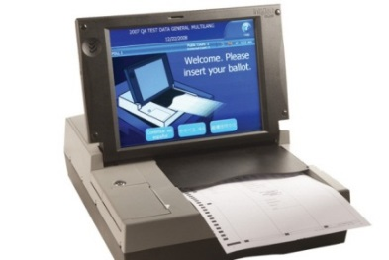
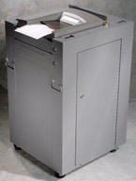
Machine Tabulating Ballots
The Election Administrator will train the appropriate judges on the tabulation equipment.
  Detailed instructions on the DS200/DS300® and the DS450/DS850/DS950® tabulators can be found in the Election Handbook and the Uniform Ballot & Voting Systems Procedures Guide.
  If your county uses one of the newly certified DS950 tabulators, your Election Administrator will provide detailed instructions.
  Get familiar with the equipment if you are a judge who will be working with it.
NOTE: Tabulation Boards will vary depending on the county. Please see the Election Handbook for information on types of boards and for detailed duties.

Slide 61
DS200®/DS300® Tabulation
    See the Election Handbook and the Uniform Ballot & Voting Systems Procedures Guide for detailed DS200/DS300 instructions.
    Seal ballots, results tape, and media in appropriate envelopes/containers for delivery to Election Office or Counting Center.
    Place signed poll book and Ballot Reconciliation Report and any other supplies in appropriate envelope and seal them (keep a copy of the Ballot Reconciliation Report outside of the sealed envelope).
    Sign all official seals and complete the Seal Log.

Slide 62
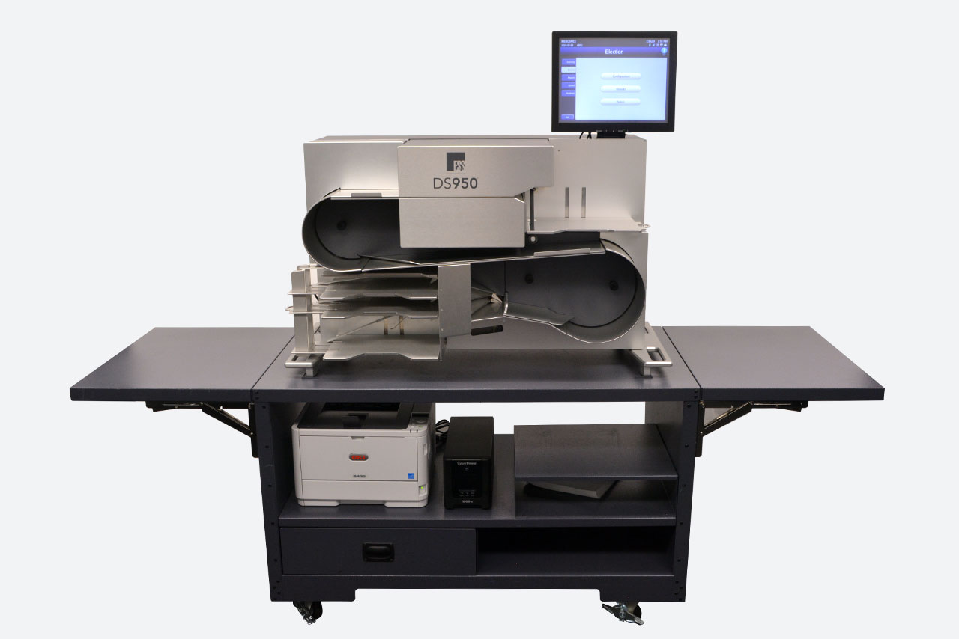
DS450®/DS850®/DS950® Tabulation
Follow the steps in “Machine Tabulating Ballots” on the previous 2 slides and:
  Upon receipt of ballot case, remove ballots after verifying seal # and signing the Seal Log.
  Inspect ballots for damage and ragged edges.
  Deliver any ballots that you determine need to be duplicated to the designated area for duplication.
See the Election Handbook, Uniform Ballot & Voting Systems Procedure Guide and any specific manuals prepared by your Election Administrator for detailed information on tabulating using the DS450®/DS850®/DS950®.

Slide 63
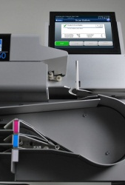
DS450®/DS850®/DS950® Tabulation (continued)
  The Models DS450/DS850/DS950 Tabulators are high-speed optical and digital scan central paper ballot counter and vote tabulators which have the capacity to route ballots to different bins depending on selected criteria (write-ins, overvotes, blank ballots).
  Tabulator Set-up
  Ensure the tabulator is on a level and stable surface.
  Check all security seals and make sure the seal numbers match the Chain of Custody and Seal Log.
  Power on the tabulator and make sure you have the correct passwords to access the machine.
  Run a predefined batch of test ballots and verify the results.
  Zero out the machine and run a report indicating the machine is set to zero before beginning tabulation.
  Make sure no ballots are in any of the ballot trays.

Slide 64
DS450®/DS850®/DS950® Tabulation (continued)
  After each precinct’s ballots are scanned, take the ballots to appropriate board for sealing.
  After all ballots are scanned, run resolution ballots through the scanner.
  Attach the computer report with the precinct totals to the appropriate precinct election results.
  Post election results at the counting center.
  Follow instructions from the Election Administrator for securing media.
  Place security seals where needed according to the Uniform Ballot & Voting Systems Procedure Guide and according to Election Administrator instructions and complete the Chain of Custody and Seal Log.
  Ensure all judges sign the applicable official seals.
  Place signed poll book, Ballot Reconciliation Report, and any other supplies in the appropriate envelope(s) and SEAL. (Keep a copy of the Ballot Reconciliation Report outside of the sealed envelope.)
  Fill out timesheets and place in them in the appropriate envelope.
  Reminder! Do NOT seal the envelope that has the timesheets!

Slide 65
Special Situations

Slide 66
Special situations election judges may encounter are included in this section.
Detailed information can also be found in the Election Handbook:
  Replacement Ballots
  Inactive Voters
  Challenges
  Disaster Response - Natural, Health Related, etc.
  Electioneering
  Equipment Problems
  Write-Ins
Special
Situations

Slide 67
Replacement Ballots
  A voter who makes an error when marking their ballot, or otherwise spoils a ballot, must be provided a replacement ballot.
    The use of stickers or labels by an election official to correct a ballot is not authorized or allowed under Montana law.
  NOTE: Be sure to make a notation in the poll book that a voter has had their original ballot spoiled and was issued a new ballot number.

Slide 68
Inactive Voters
  Inactive voters are not late registrants.
    Inactive voters are voters who did not vote in a prior general election and did not respond to two confirmation mailings, or who had an undeliverable mail ballot and did not respond to a forwardable mailing.
  Inactive voters may appear at the polling place and vote one last time at their previous address/precinct.
    Have the voter fill out a new Voter Registration form for future elections if their address or other information has changed.

Slide 69
Challenges
  Any elector may challenge another elector’s right to vote on election day.
  Keep a record of all election day challenges on the form provided.
  An Affidavit of Challenge form should be provided to the elector offering the challenge.
  The Challenger’s signature on the Affidavit must be witnessed by an election official or notary.
  A challenge may be made on the grounds the elector:
      is of unsound mind, as determined by a court;
      has already voted in the current election;
      has been convicted of a felony and is currently serving a sentence in a penal institution;
      is not registered as required by law (not of age or not a resident of the state for at least 30 days);
      is a provisionally registered elector whose status has not been changed to legally registered; or
      does not meet another requirement provided in the constitution or by law.

Slide 70
Challenges (continued)
  Challenged individuals should be provided with the Affidavit of Challenged Voter form.
    If challenged individual swears under oath administered by an election judge that they are qualified to vote, then the CHALLENGE IS RESOLVED IN FAVOR OF THE VOTER AND THEY ARE ALLOWED TO VOTE A REGULAR BALLOT.
    If challenged individual does not swear to the individual’s qualifications under oath, or if challenge is not able to be resolved in favor of the voter, then SEND THEM TO PROVISIONAL JUDGE TO CAST PROVISIONAL BALLOT.

Slide 71
Natural Disasters, Health-Related Disasters, Electrical Outages, and other Election Day Problems
  In the event of a serious situation on election day, notify the Election Office immediately!
  Follow county emergency protocol and your Election Administrator’s Disaster and Contingency Plan.
  Have a list of emergency contacts handy.
  Refer to the Election Disaster and Contingency Plan Polling Place Relocation Checklist in the Election Handbook.

Slide 72
Electioneering
  No electioneering may occur within 100 feet of a polling place entrance ON election day.
    Establish your polling place’s 100 feet boundary as soon as possible on election day.
    Electioneering includes wearing clothing, buttons, etc., indicating support or opposition to any candidate or issue on the ballot.
  See the Election Handbook for additional information pertaining to polling place conduct.

Slide 73
Equipment Problems
  A random test must be conducted by a county Election Administrator or designee of 10% of each type of voting systems, a minimum of one per county on election day, to validate the accuracy of voted paper ballots with the voting system results.
  Make sure all equipment is set up and functioning properly before the polls
  open.
  When time permits, check the equipment throughout the day to ensure it is working correctly.
  If equipment does not seem to be operating correctly, call the county Election Office immediately.
NOTE: For specific equipment problems, see the Election Handbook Troubleshooting Guide.

Slide 74
Write-Ins
  A list of declared write-in candidates will be provided by the Election Administrator.
  You should provide a copy of the list to an elector ONLY if they request it.
  Your Election Administrator will advise you on the use of labels by voters for write-in candidates. Use of labels by voters may vary depending on the type of equipment (if any) used.
  An elector has the option to write in the name of a candidate of choice, whether there is a qualified candidate or not.
  Counting Write-in Votes
      Write-ins votes are counted only for any candidate who filed a “Declaration of Intent for Write-in Candidate.”
      See Election Handbook section on counting write-in votes for detailed instructions.

Slide 75

A Chief Election Judge or Official should NOT serve in a precinct where a voting system is used unless the judge:
    has received the required instruction on the voting system(s);
    is fully qualified to perform duties in connection with the system(s); and
    has received a Certificate of the above from the Election Administrator.

Slide 76
An Election Judge or Official should NOT:
  Deposit a ballot in the ballot box that does not contain
  the official stamp, unless the judges agree that the missing
  stamp is due to election judge error.
  Open or examine the folded ballot of an elector before putting the ballot in the ballot box.
  Look at any mark upon the ballot by the elector.
  Allow an individual other than the elector to be present at the marking of the ballot, unless the elector has a disability and chooses someone to aid.
  Make a false statement in a certificate regarding affirmation.
  Turn away any voter from the polls.
  Express their opinion(s) while in their official capacity regarding any election subject.
      These actions could result in charges of official misconduct or a misdemeanor.

Slide 77
Summary
CALL the county Election Administrator for assistance with polling place or tabulating issues.
READ the Election Handbook and the Uniform Voting System Guide.
REVIEW the Polling Place Forms.
HELP each voter through the process of casting a ballot.
NOTE: Do NOT turn any voters away. The Help America Vote Act ensures every individual may cast a regular or provisional ballot.

Slide 78
Quiz

Slide 79

Take the Montana Election Judge Quiz to see how much you learned.
The Quiz answers are at the end of the presentation:
            The first section of the Quiz is True or False.
            The second section is Multiple Choice.

Slide 80
Election Judge Training QUIZ
True or False:
Anyone who serves as an election judge must be trained every year and receive a certificate from the county Election Administrator upon completion of the training.
A candidate whose name appears on the ballot in a precinct can’t be a poll watcher at that precinct.
If a voter states they cannot sign the precinct register because of a disability, you should send them to a provisional judge to vote a provisional ballot.
Political buttons, t-shirts, etc. that show support or opposition to any candidate on the ballot can be worn in the polling place if it is not the candidate themselves wearing one.
A list of declared write-in candidates must be posted at each polling place.
A voter whose name does not appear in the precinct register must be sent to the Election Office for late registration.
For a primary election, the voter must tell you which party ballot they want to vote, and you hand them that ballot only.
Multiple Choice:
1. A voter with a disability chooses to use the ExpressVote® to vote, but the ExpressVote® does not appear to be working. You should:
  Tell the voter they will have to vote their ballot with assistance from election judges.
  Review the ExpressVote® troubleshooting sections in the Election Handbook. If that doesn’t help, call the Election Office to see if there is a spare ExpressVote® that can be quickly delivered to your polling place. If not, give the voter the option to vote at another, close polling place, or to go to the Election Office to vote on the ExpressVote® if there is no close polling place, or to vote with assistance from 2 election judges or from a person of their choice.
  Send the voter to the provisional judge to vote a provisional ballot.

Slide 81
2. A voter who is not a late registrant drops off an absentee ballot at a polling place other than the one where they are registered. You should:
  Tell the voter they must take it to the correct precinct, or if you do not catch the voter, reject the ballot.
  Remove the secrecy envelope from the signature envelope and drop the secrecy envelope into the ballot box.
  Deliver the absentee ballot in the signature envelope to the Election Office for signature verification. If all ballots are counted at the polls, the election office will deliver the verified ballots to the appropriate poll location for counting.
3. A voter shows photo ID, but the address on the photo ID does not match the address in the precinct register. You should:
  Have the voter fill out a new registration application to update their address and send them to the correct precinct to vote.
  Pay no attention to the address, if any, on the photo ID.
  Send the voter to the provisional judge to vote a provisional ballot.
  Send the voter to the Election Office to late register at the address on their photo ID.
4. A voter at the polls states that they don’t have an acceptable ID and can’t get back to the polling place on election day with ID but can send in a copy the day after the election. You should:
  Send the voter to the provisional judge to vote a provisional ballot.
  Do not provide a ballot to this voter until they bring in photo ID.
  Ask the voter for if they have their voter confirmation card.
5. A voter who is listed as “Inactive” in the precinct register appears to vote. You should:
  Send the voter to the Provisional Judge to vote a provisional ballot.
  Have them fill out a voter registration application if their information needs to be updated and allow them to vote a regular ballot.
  Send them to the Election Office to late register.
6. A voter who is listed in the precinct register as having been issued an absentee ballot shows up to vote. You should:
  Ask if their ballot was not received, lost or destroyed, and if the answer is yes, let them vote a regular ballot.
  Call the Election Office, and if they indicate the absentee ballot has not been returned or was undeliverable, let them vote a regular ballot.
  Send the voter to the Provisional Judge to vote a provisional ballot.

Slide 82
7. A voter indicates that they have made a mistake on their ballot. You should:
  Provide them with a sticker and instruct them to place the sticker over the mistake and continue voting the ballot.
  Give them the option of correcting the ballot with a sticker or receiving a new ballot.
  Remove the ballot stub, mark the stub as Spoiled, and place the stub in the stub box. Have the elector mark their ballot as Spoiled and place it in an envelope for Spoiled ballots. Place the Spoiled Ballot Envelope in the ballot box. Issue a new ballot after instructing the Poll Book Judge to log the Spoiled ballot and Reissued ballot in the poll book.
8. A voter wrote in a name of a declared “write-in” candidate as demonstrated below. This vote should be:
Ben Smith
Art Jones
Steve Johnson
  Counted for the “write-in” candidate because the intent of the voter is clear.
  Designated as an undervote because no oval was filled in.
9. A voter has been challenged by a poll watcher based on differing addresses listed in the precinct register versus the postal address list that the poll watcher is using. You should:
    Send the voter to the provisional judge to vote a provisional ballot.
    Reject the challenge unless the voter confirms in writing that the postal service address is the correct residence address. They still may choose to vote one last time in their old precinct.
    Send the voter to the Election Office.
    Approve the challenge and do not allow the voter to vote because the postal service address list would probably be more updated than the voter registration list.

Slide 83
Election Judge True False Quiz Answers
True/False Choice Answers:
1. False
2. True – A candidate may no serve as a poll watcher at a polling place where electors are voting on ballots with the candidate’s name on them (13-13-120(2) MCA).
3. False - a voter with a disability can make a mark in the register or have a designated agent sign for them.
  You should note in the register that you witnessed the elector making the mark.
  If an elector is unable to provide a fingerprint or an identifying mark and the elector has not established an agent, the Election Administrator or an election judge may sign for the elector after reviewing and verifying the elector's identification.
4. False - no political buttons, t-shirts, etc. can be worn in the polling place or within 100 feet of any entrance to a polling place by anyone.
5. False - the list of declared write-in candidates can be provided to a voter upon request but cannot be posted in the polling place.
6. False - you should first look to see if the person appears in another precinct register, look to see if they are somehow out of alphabetical order (sometimes data entry mistakes can put a person out of alphabetical order), and if you still cannot find them, attempt to verify with the Election Office that the person was not erroneously omitted due to registering with MVD or another Agency. Only after a thorough investigation should you send the person to the Election Office.
7. False - in a Primary election a voter is provided all party ballots, and in private can select which party ballot to vote.

Slide 84
Election Judge Multiple Choice Quiz Answers
Multiple Choice Answers:
1. B - The ExpressVote® troubleshooting sections in the Election Handbook should be reviewed. If that doesn’t answer the question, attempt to have a functioning ExpressVote® delivered to replace the machine that is not working; if that is not possible, the voter has the option to vote at another, close polling place, or at the Election Office, on an ExpressVote®, OR receive assistance from 2 election judges or from a person of their choice to mark their ballot.
2. C - A voter must be allowed to drop off an absentee ballot at any polling place in the county, but the ballot must be sent to the Election Office for signature verification and tabulation. If all ballots are counted at the polls, the Election Office will deliver the verified ballot to the appropriate polling place for counting.
3. B - If the voter presents photo ID, you only verify that the photo is indeed the voter. The photo ID is for identification only, not for verifying voter registration information.
4. A – Send the voter to the Provisional Judge to vote a provisional ballot. The voter needs to present acceptable ID at the polling place to vote a regular ballot. They can always vote provisional ballot and either deliver or mail a copy of the ID to the Election Office the next day. See Provisional Voting in the Election Handbook for more information.
5. B - An Inactive voter does not have to late register; such voters reactivate their registration by appearing to vote. If their residence address has changed, they can vote one time at their previous precinct.
6. C - Any voter listed in the register as “Absentee” who asks to vote at the polls must vote a provisional ballot at the polls – no exceptions!
7. C - Ensure that the privacy of the voter’s ballot is not at risk by having the voter mark the ballot as Spoiled and place it in the envelope for Spoiled ballots. A voter must be provided with a replacement ballot; stickers or labels are not allowed to correct ballots.
8. B - This is an undervote – according to the law and uniform rules, the name must be written in AND the designated voting area must be marked for the write-in candidate for the vote to be counted.
9. B - A challenge based on a residential address must fail unless the voter confirms in writing that their address has changed. Even if they confirm in writing that their address has changed, they still may choose to vote one last time in their old precinct.

Slide 85
Montana Secretary of State, Election and Voter Services
State Capitol Building
1301 E. 6th Ave, Room 260
PO Box 202801
Helena, MT 59620
sosmt.gov soselections@mt.gov 406-444-9608 or 888-884-8683
CONGRATULATIONS!
You have completed the 2024 Election Judge Training!
Congratulations! You have completed the 2024 Election Judge Training!

